Slide 1
How Slow Can You Go?: Lease Maintenance Issues and Strategies in a Low Oil Price Environment
James H. Dupuis, Jr.
Dupuis & Polozola
The Woodlands, TX
February 25, 2016

Slide 2
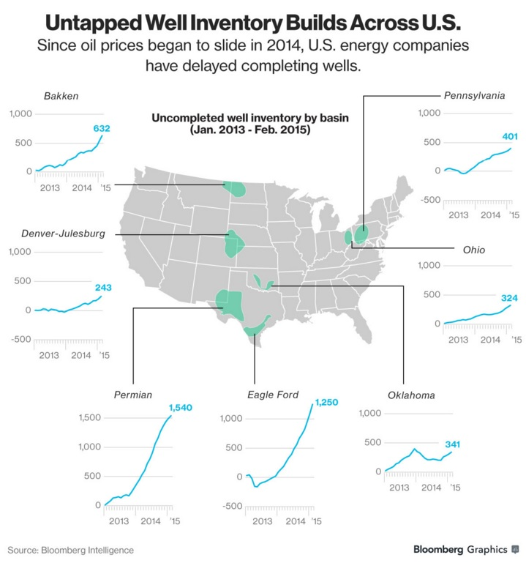
Drilled but Uncompleted Wells (DUC)
http://www.bloomberg.com/news/articles/2015-04-23/u-s-shale-fracklog-triples-as-drillers-keep-oil-out-of-market-i8u004xl (April 23, 2015)

Slide 3
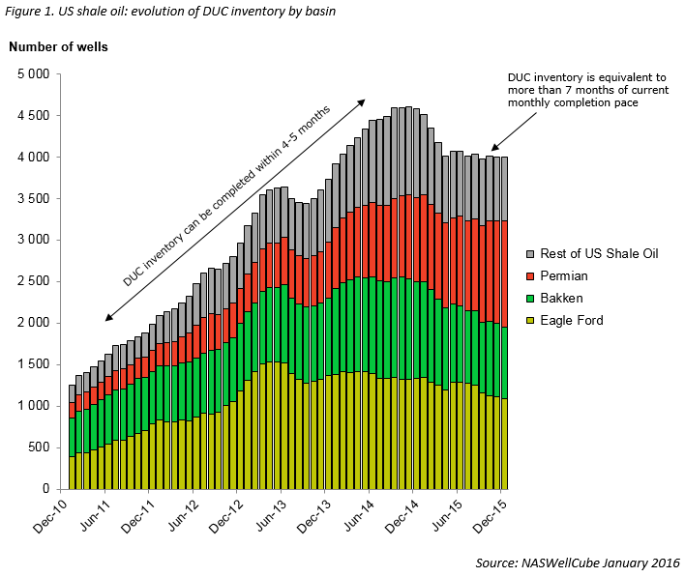
DUC contd.
http://seekingalpha.com/article/3907176-look-u-s-oil-production-2016

Slide 4
DUC contd.
Are they legal?
North Dakota restrictions
Does lease allow it?
Still within PT?
Agreement with Lessor to delay completion
Is there an implied obligation to complete within a specified time?

Slide 5
Lease Maintenance after the PT
(1) Production in paying quantities (PPQ)
(2) Savings clause
Shut In
Continuous Operations
Continuous Development
Pooling

Slide 6
Production in Paying Quantities (PPQ)

Slide 7
PPQ Test: Clifton v. Koontz
1: Income > operating and marketing costs?
No requirement to show that well will ever pay out
2: “…whether or not under all the relevant circumstances a reasonably prudent operator would, for the purpose of making a profit and not merely for speculation, continue to operate a well in the manner in which the well in question was operated.”
Lessor has burden of proving both parts

Slide 8
PPQ Part 1
What is “operating and marketing” cost?
Lifting expenses and fixed or periodic expenditures in the daily operation of the well
Taxes, labor, repairs
Overhead directly related to production (not overhead that continues regardless of production)
Depreciation on salvageable equipment
NOT capital expenses, such as lease acquisition, drilling and equipping, or reworking (“sunk” costs)
“Breakeven point”

Slide 9
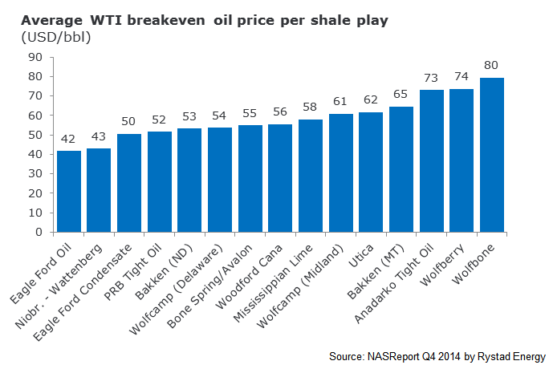
PPQ Part 1
WTI Breakeven point: December 2014
http://www.rystadenergy.com/AboutUs/NewsCenter/Newsletters/UsArchive/us-q1-2015

Slide 10
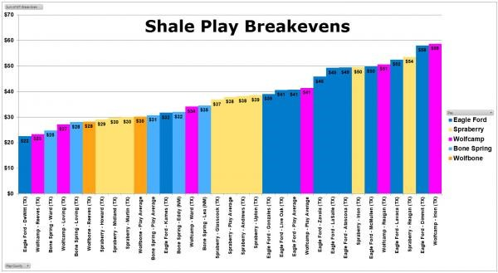
PPQ Part 1
WTI Breakeven point: early 2016
http://oilprice.com/Energy/Crude-Oil/Why-US-Shale-Is-Not-Capitulating-Yet.html

Slide 11
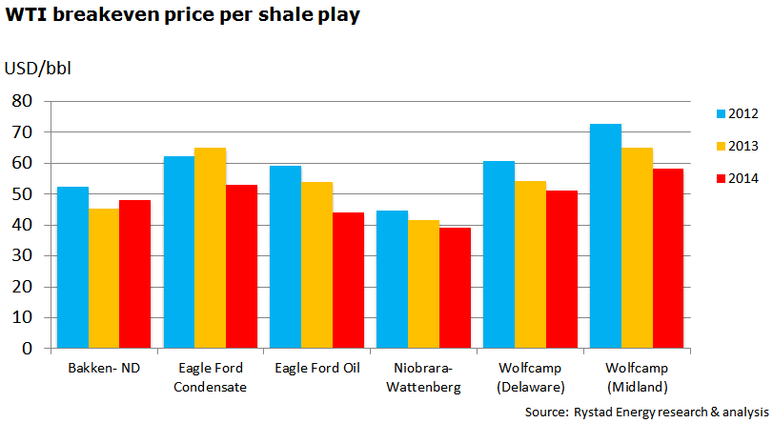
PPQ Part 1
Downward trend
http://www.rystadenergy.com/AboutUs/NewsCenter/Newsletters/UsArchive/us-q1-2015

Slide 12
Reduction in Breakeven Point
Lower costs
Sweet spots
Longer laterals
Multiple wells from one surface location
Improved fracking technologies

Slide 13
PPQ Part 2
Reasonably Prudent Operator Standard
… whether or not, under all the relevant circumstances, a reasonably prudent operator would, for the purpose of making a profit and not merely for speculation, continue to operate a well in the manner in which the well in question was operated.

Slide 14
PPQ Part 2
Is it speculative to hold an unprofitable well with the expectation that prices will rise?
If not, how long can an operator hold?
Reasonable period of time under the circumstances
Courts do not look to any specific time/accounting period to determine profitability
TX cases: more than 8 months; 21 months

Slide 15
No PPQ?: Savings Clauses

Slide 16
Shut In Royalties
Permits the lessee of a gas well to shut in the well in return for making payment of a contractually specified amount to the lessor.

Slide 17
Shut In Royalties
Constructive production
TX: Strict compliance
Timely
Right amount
To the right entity
Payment to original Lessor rather than Lessor’s successor in interest after conveyance of the minerals and notice thereof to Lessee terminated lease

Slide 18
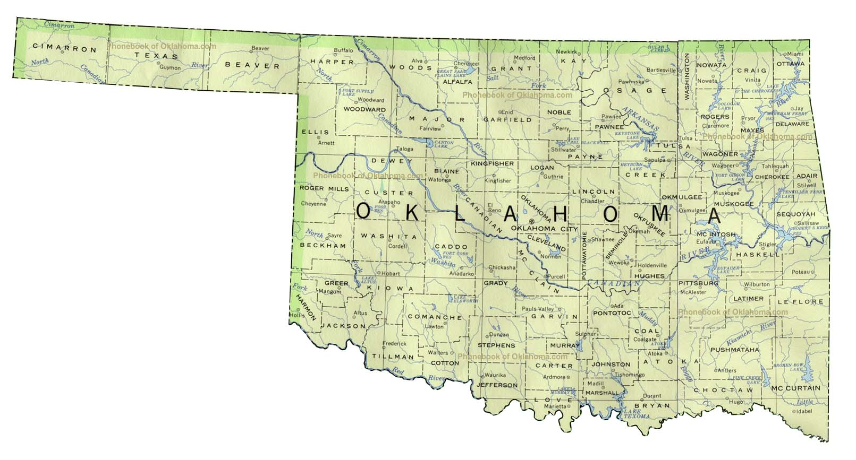
Shut In Royalties
Compare OK: Not a substitute for production
Compensation/royalty provision
Lease will not automatically terminate, only breach of a lease covenant

Slide 19
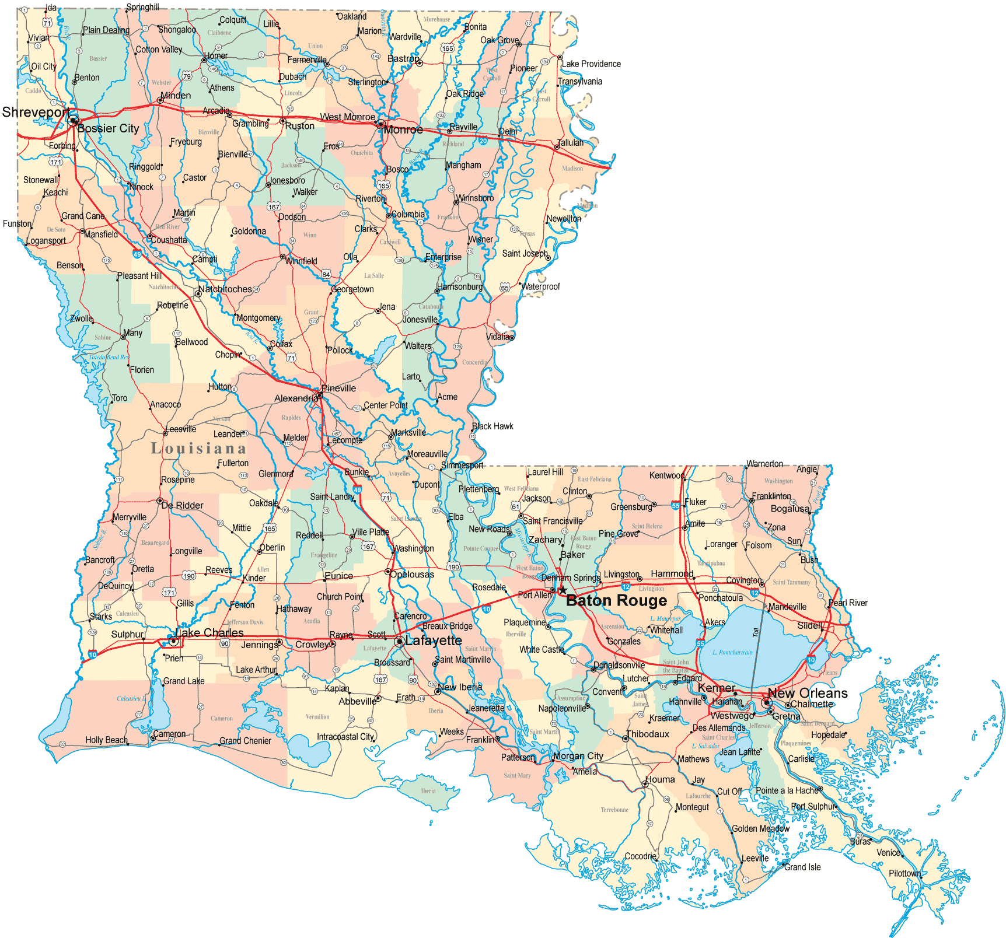
Shut In Payments
Compare LA: It depends
Shut in payments classified as either royalty or rental, depending on lease form
Payee?
Time for payment?
Consequences for failure to pay?

Slide 20
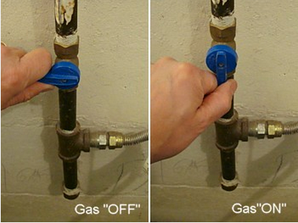
Shut In Royalties
Well must be capable of PPQ
Can be turned “on” and begin flowing without additional equipment or repair

Slide 21
Shut In Royalties
Well must be capable of PPQ
Marketable quantity vs. quality
Un-fracked well?

Slide 22
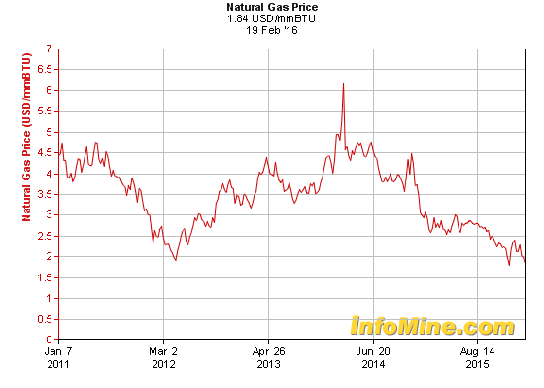
Shut Ins vs. Depressed Market
Can you shut in a well because of a depressed market?
Lease form; would a Reasonably Prudent Operator shut in?
If at any time after the expiration of the primary term of a lease that . . . Oil or Gas is not being produced for lack of suitable production facilities . . . or lack of a suitable market…
http://www.infomine.com/investment/metal-prices/natural-gas/5-year/

Slide 23
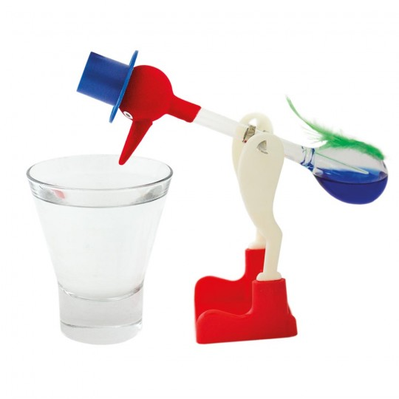
Continuous Operations

Slide 24
Continuous Operations
“Operations” for drilling or reworking a well are substitute for PPQ
Clauses are construed liberally

Slide 25
Levels of Scrutiny
Operations
Lowest
Drilling Operations
Middle
Actual Drilling Operations
Highest

Slide 26
What “operations” are sufficient?
Putting up part of an oil derrick, beginning work on a well to be used to supply water for drilling, and setting a joint of surface casing?
Putting in a road/constructing drilling pad?
Beginning a survey the day before end of PT and putting a stake in the ground on the last day?
Obtaining a drilling permit from RRC?
No, physical activity is required

Slide 27
Is physical activity alone sufficient?
What if physical operations are being performed while evaluating results from a nearby well and attempting to obtain financing?
Must INTEND (in good faith) to complete a well, without contingencies

Slide 28
Drilling Operations
Courts interpret this more strictly than “operations”
Generally requires operations “preliminary to the actual work of drilling”

Slide 29
Drilling Operations: Ex. 1 Yes
Clearing location
Digging working pits and reservoirs
Moving in a drilling rig
Delivering a draw-works to the location
Start rigging-up

Slide 30
Drilling Operations: Ex. 2 Yes
Making a location for the well
Bringing materials to location
Digging a slush pit and well for water
Erecting steel derrick

Slide 31
Drilling Operations: Ex. 3 No
Long-stroking an existing oil well
Laying pipeline to a gas wells
Doing electrical work on the lease
Installing, checking, and repairing flow lines
Replacing a tank
Allowing all of the equipment to remain on

Slide 32
Drilling Operations Ex. 4 No
Back dragging of grass with a back hoe on the last day of the primary term to mark the location of a road

Slide 33
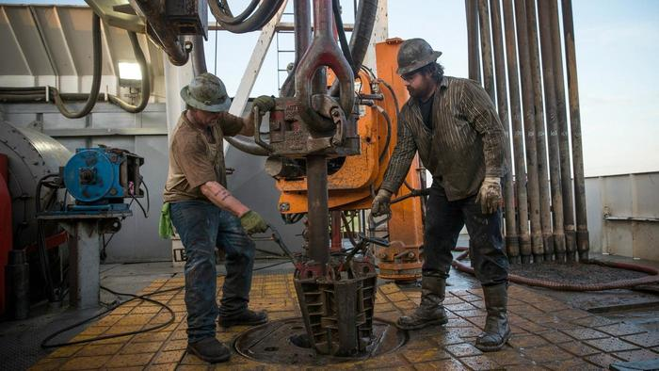
Actual Drilling Operations
No case law, but likely requires spudding
i.e. actual penetration of the ground by a drill bit

Slide 34
Continuous Development & Retained Acreage Clauses

Slide 35
Continuous Development Clause
After initial well, requires additional wells within certain time periods
Sanction for noncompliance is partial termination of lease
Retained Acreage Clause
Does not establish a specified drilling program or requires wells to be drilled within certain times
Simply states that each well will hold only a certain number of acres

Slide 36
… lessee shall conduct a continuous drilling program on the lands covered by this lease, with no more than 120 days between the completion of one well and the commencement of operations for the drilling of a succeeding well.
Upon cessation of such continuous drilling program, this lease shall terminate as to all lands covered hereby except for lands that are contained within a spacing or proration unit for which there is a producing oil or gas well.

Slide 37
Time Between Operations
Completion of one well …
Undefined – drilled and logged on one end; on the other end, drilled, cased, perforated, stimulated, tested, and physically connected to a pipeline or outlet.
Reaches TD
Potential test report with RRC
Rig release

Slide 38
Time Between Operations
Completion of one well …
“As used herein, completion shall be deemed to be the earliest of the following dates: (1) the date on which the initial potential test is run, (2) the date on which a dry hole is plugged, (3) the date 30 days after the date on which total depth is reached, or (4) the date certified to the RRC as the date a well has been completed as a producing well.”

Slide 39
Time Between Operations
Commencement of a well …
i.e. drilling operations
“…the date lessee commences actual drilling with a rig capable of reaching depths from which lessee may, in good faith, anticipate the production of oil or gas.”
Deep rights leases?

Slide 40
Time Between Operations
Accumulate time between wells?
Substitute well if first well is lost?
Reworking of a previously drilled well?

Slide 41
Size/Amount of Retained Acreage
Specific Number?
Tied to governmental authority?
Contiguous?
Yes. Mayfield v. DeBenevides, 693 S.W.2d 500 (Tex. App. – San Antonio, 1985)
Designation/Release required?

Slide 42
Size/Amount of Retained Acreage
3/4 MI
RA Tract 1
RA Tract 1
RA Tract 2
Does a well continue to maintain a lease as to specified acreage after the well has ceased producing?

Slide 43
Size/Amount of Retained Acreage
RA Tract 1
RA Tract 2
… lease is maintained as to 40 acres designated as a well block around each producing well.
Humphrey v. Seale, 716 S.W. 2d 620 (Tex. App. – Corpus Christi 1986)

Slide 44
Effect of other lease clauses
“Notwithstanding anything in this lease agreement to the contrary” lessee shall release all rights in zones and formations that are not producing in paying quantities six years from the effective date hereof …

Slide 45
Effect of other lease clauses
“Notwithstanding anything in this lease agreement to the contrary” lessee shall release all rights in zones and formations that are not producing in paying quantities six years from the effective date hereof …
Well temporarily plugged two months before the date; and production restored ten days after

Slide 46
Effect of other lease clauses
“Notwithstanding anything in this lease agreement to the contrary” lessee shall release all rights in zones and formations that are not producing in paying quantities six years from the effective date hereof …
Well temporarily plugged two months before the date; and production restored ten days after
Rights governed by 90 day cessation of production clause
Judice v. Mewbourne Oil Co., 890 S.W.2d 180 (Tex. App – Amarillo 1994;
aff’d in part, rev’d in part, 939 S.W.2d 133 (Tex. 1996).

Slide 47
Lease Language & Field Rules
“The term ‘well unit’ shall mean the proration unit created for a well as prescribed or permitted by the applicable rules…”
Field Rules provide for standard proration units of 320 acres, but allow for up to 640 acres for maximum allowable
Assign 320 acres in P-15 with RRC

Slide 48
Pooling vs. Retained Acreage
Pooling clause: 160 acre pooled units
Retained Acreage: 160 acre proration units… “provided that….any such units may embrace as much additional acreage as may be so prescribed or permitted…”
Special Field Rules allow for up to 320 ac units

Slide 49
Pooling vs. Retained Acreage
Pooling Clause
RA Clause

Slide 50
Good Faith vs. Bad Faith Pooling
Lessee must pool in good faith
Even if unit formed is authorized by lease
Whether pooling in bad faith is an issue of fact
Factors:
Failure to consider geology
Pooling to maintain leases (timing)
Inclusion of unproductive acreage/acreage outside of a well’s drainage pattern
Gerrymandering (irregular shaped units)

Slide 51
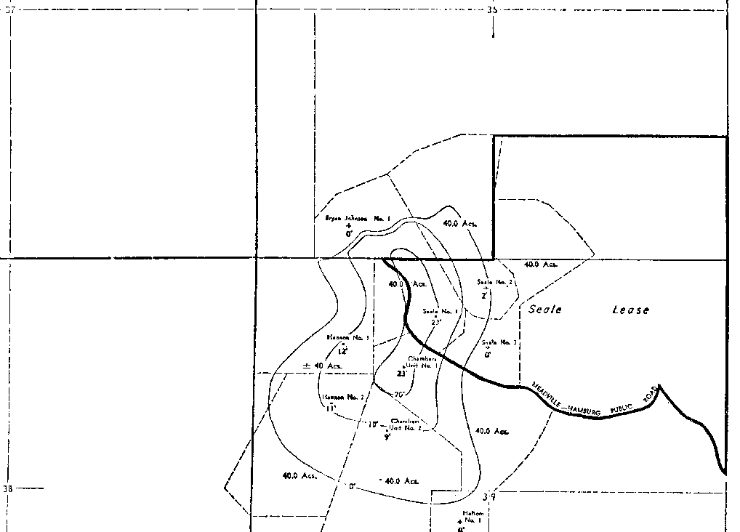
Gerrymandering

Slide 52
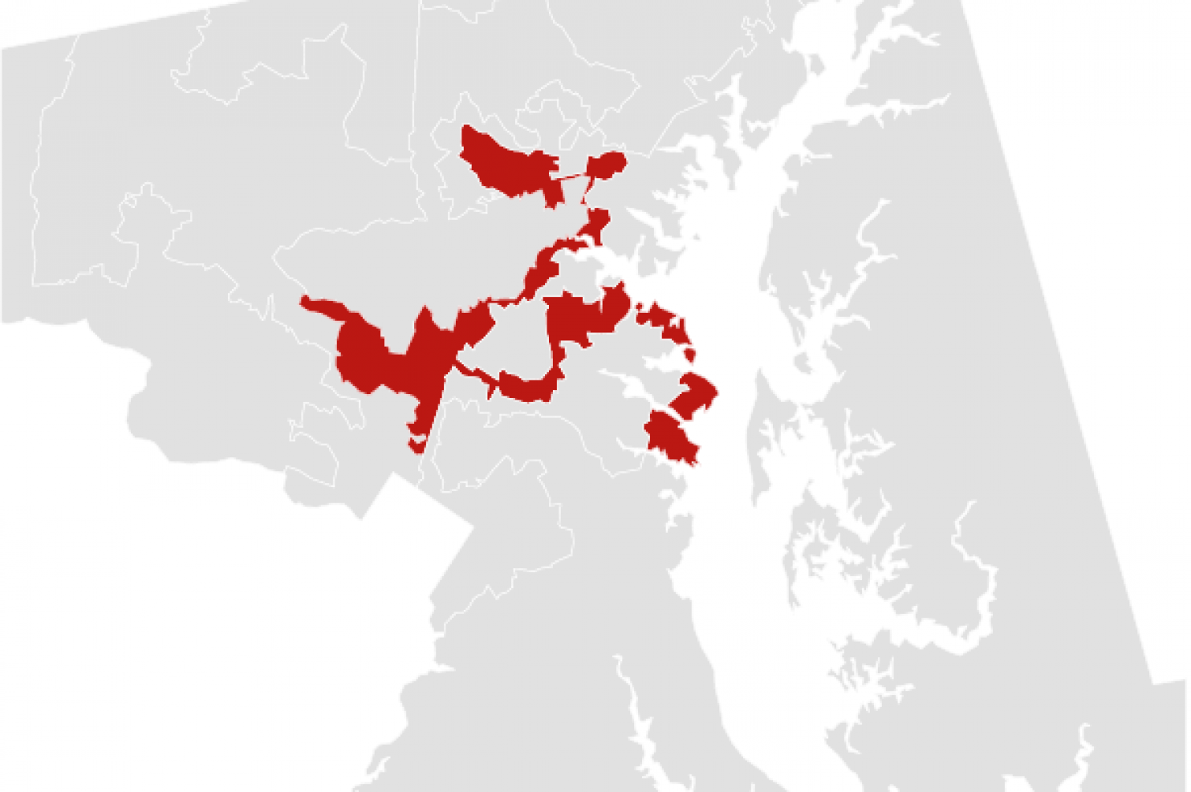
Maryland’s 3rd District “The Praying Mantis”
https://www.washingtonpost.com/news/wonk/wp/2014/05/15/americas-most-gerrymandered-congressional-districts/

