Slide 1
Cemetery Law for Landmen Is drilling a well in the dead center of a cemetery a grave mistake?
Jimmy Dupuis
NHAPL Luncheon
November 14, 2017

Slide 2
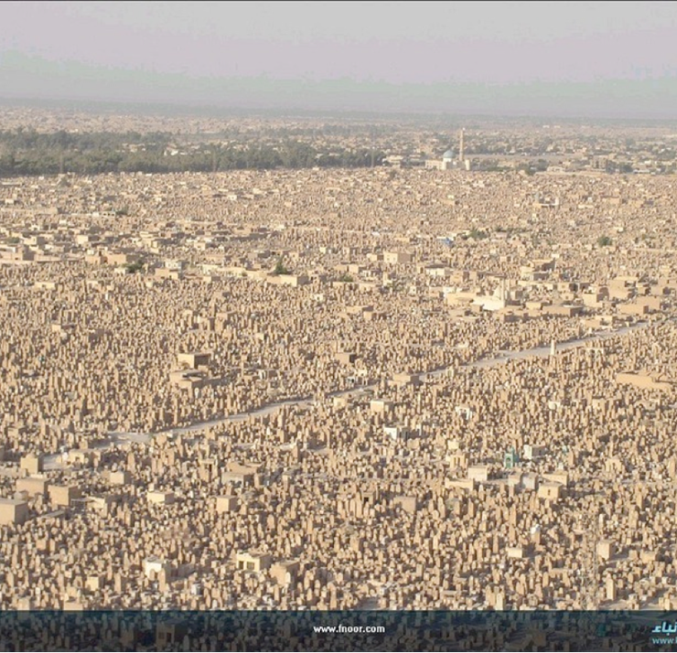
Wadi-us-Salaam 1,485.5 acres 5,000,000 burials

Slide 3
Calvary Cemetery, Queens, NY
365 acres
3,000,000 burials

Slide 4
Captain Joe Byrd Cemetery, Huntsville TX
22 acres
2,100+ burials

Slide 5
Evergreen Cemetery
Paris, TX
40,000 graves
Willett Babcock
Cabinet Maker

Slide 7
Why are cemeteries important?
Owner of cemetery lands is limited in its use
Public Policy (all states)
protects cemeteries from desecration
prevents injury to the public, and actions detrimental to the community and the public good
restricts freedom of contract and ownership
Dedication: once a cemetery, always a cemetery

Slide 8
Why are cemeteries important?
Exempt from condemnation by expropriation, taxation, liens
Owner holds title “in trust” fbo family members and other loved ones of the deceased, who have visitation rights, and standing to sue for desecration
Status as cemetery is not always evident from deed records

Slide 9
Source of cemetery law?
Common Law
TX Case Law
TX Statutes: Health & Safety Code, Chapters 711 to 716

Slide 10
What is a cemetery?
Place that is used or intended to be used for interment
Interment = permanent disposition of human remains by:
(1) entombment (mausoleum)
(2) burial (graveyard)
(3) placement in a niche (columbarium)
Includes avenues, walks, and grounds devoted to shrubbery and ornamentation

Slide 12
How is a cemetery created?
“Formal” Dedication
“Informal” Dedication

Slide 13
“ … unto the said trustees … for the use and benefit of said church, as a public cemetery.”
occupied with graves
timber and underbrush, not suitable a burial ground
Barker v. Hazel-Fain Oil Co., 219 SW 874 (Tex. Civ. App – Fort Worth 1920)

Slide 14
Deed + Actual use of part of land as a cemetery
=
Dedication of the land to that purpose

Slide 15
Does dedication require a deed?
No, physical presence of tombstones and graves is sufficient to effectuate a dedication

Slide 16
How long does a dedication last?
Until (1) the dedication is removed by court order, or (2) the maintenance of the cemetery is enjoined or abated as a nuisance
Not affected by dissolution of the cemetery organization, non-use as a cemetery, forced sale
Dedication is not abandoned if grounds no longer cared for

Slide 17
Can you un-dedicate an abandoned cemetery?
District court can order the removal of a dedication for cemetery purposes if it finds the removal to be “in the public interest”
All human remains must be removed – sent to perpetual care cemetery or municipal or county cemetery

Slide 19
What if you discover an unknown cemetery?
File notice of discovery with the County clerk, and
mail notice to landowner on record in appraisal district within 10 days of the discovery
Notice must contain:
legal description of tract
approximate location of the cemetery
what evidence of the cemetery that was discovered

Slide 20
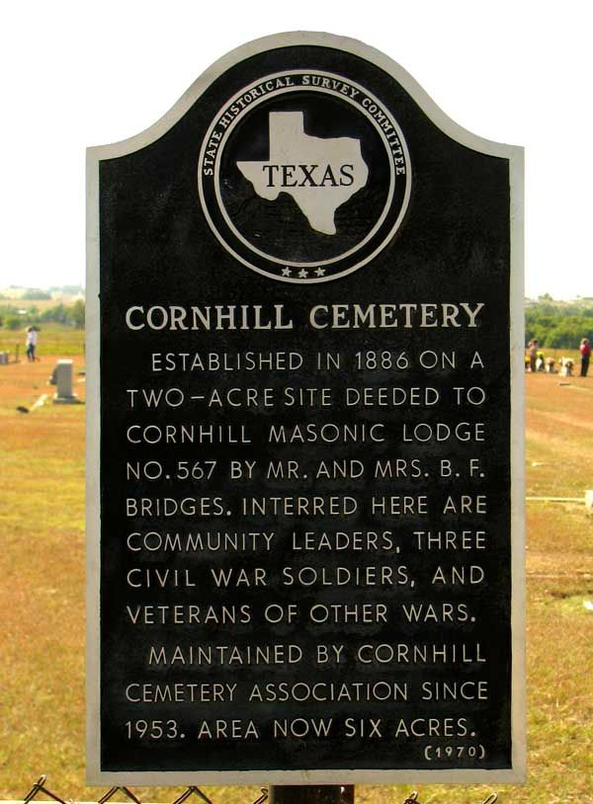
What if you discover an unknown cemetery?
County clerk sends copy of notice to Texas Historical Commission

Slide 21
What can you do on cemetery lands?
Property must be used exclusively for “cemetery purposes”
Any purpose necessary or incidental to establishing, maintaining, managing, operating, improving, or conducting a cemetery, interring remains, or caring for, preserving, and embellishing cemetery property

Slide 22
Authority of Cemetery Keeper
The person in charge of a cemetery (superintendent, sexton) has all the same powers, duties, and immunities granted by law to:
A police officer in the municipality where the cemetery is located
Constable or sheriff of the county, if not in a municipality

Slide 23
Authority of Cemetery Keeper
Duties include maintain order, enforce the cemetery organization’s rules, state law, and municipal ordinances
Applies not only in the cemetery, but also outside the cemetery “as near the cemetery as necessary to protect cemetery property”

Slide 24
Cemetery ownership
Cemetery corporation or association
Church or religious society (trustees, pastor, board)
State, County, Municipality

Slide 25
Cemetery ownership
Record/legal title, for the benefit of:
Owners of the right to be buried
Loved ones of those buried

Slide 26
What do you own when you buy a plot?
An interest in land passes to the purchaser, but NOT ordinary fee title
Right of burial = analogous to an easement, license, privilege

Slide 29
What do you own when you buy a plot?
After interment, plot cannot be sold or mortgaged
Relatives of person buried in a plot have no rights except visitation, ornamentation, protection from desecration
No ownership of minerals or right to receive lease benefits

Slide 30
Can you buy an oil and gas lease on cemetery lands?
Historically, no
Currently, yes
Surface use restrictions in oil and gas lease?

Slide 31
Can you drill a well in a cemetery?
No
“Those who have loved ones buried [in the cemetery] are entitled to have the hallowed spots protected from the heedless search for hidden wealth and from the rapacious hands who would convert its sacred confines into a place of money getting.”
Cochran v. Hill, 255 SW 768 (Tex. Civ. App. – Fort Worth 1923)

Slide 32
Can you drill a well near a cemetery?
Yes, as long as the operations do not desecrate the adjacent cemetery lands
59 feet from cemetery boundary
No oil was allowed to mar the graves
No trash or other property in the cemetery
Meadows v. Edwards, 116 SW 2d 831 (Tex. Civ. App. – Texarkana 1938)
Noise, dust, view, nuisance?

Slide 33
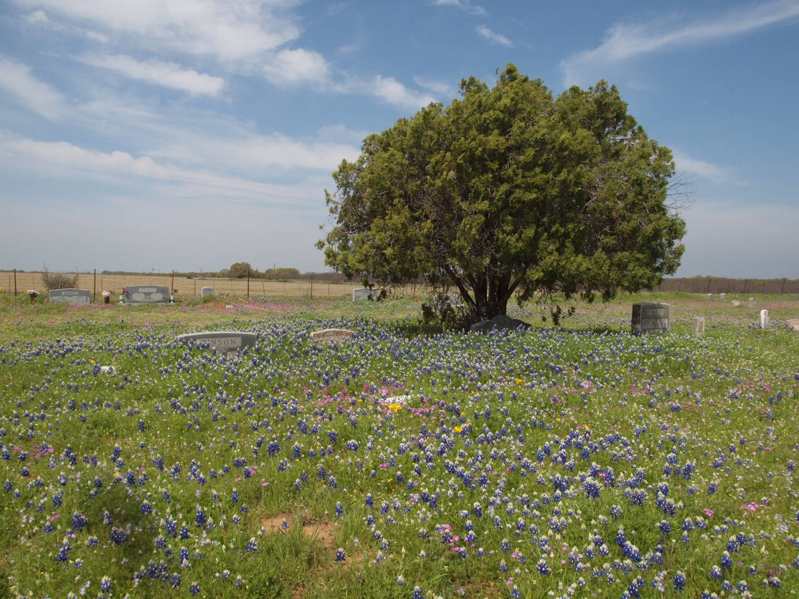

Slide 37
Can you put a pipeline, road, wind turbine, cell tower, other public utility through a cemetery?
Yes, but only with the consent of:
(1) The directors of cemetery organization, or
(2) At least 2/3 of the owners of plots in the cemetery

Slide 40
Can you drill a well under a cemetery?
Probably, but that cannot desecrate the cemetery.
Directional well from tract next to a cemetery, bottomed underneath the cemetery
Legality of the well was not an issue in the lawsuit
Lake v. Reid, 252 SW 2d 978 (Tex. Civ. App. – Texarkana 1952)

Slide 41
Can you drill a well under a cemetery?
No cases to date on the issue of horizontal wells and cemeteries
Case law and rules were established when vertical wells were the norm

Slide 42
Can you drill a well under a cemetery?
If activities do not desecrate the cemetery, you can drill 59 feet from boundary (Meadows v. Edwards)

Slide 43
Can you drill a well under a cemetery?
“Cemetery purposes” includes activities necessary or incidental to maintaining, improving, caring for, and embellishing cemetery property
Requires that money received be used for “cemetery purposes”?

Slide 44
Can you drill a well under a cemetery?
You can run a pipeline, road, electric line, wind turbine, cell tower, or other public utility with consent

Slide 45
Can you drill a well under a cemetery?
Subsurface trespass law may be relevant
Coastal v. Garza Energy Trust, 268 SW 3d 1 (Tex. 2008)
ROC precluded claim of subsurface trespass
ad coelum doctrine: whoever owns the soil owns up to heaven and down to hell

Slide 46
Can you drill a well under a cemetery?
Texas Cemetery Association
Encourages development of oil and gas under cemeteries
Money received by cemeteries is a benefit to the cemetery association and loved ones
Assist with upkeep, perpetual maintenance and repair of cemetery property

Slide 47
New Mexico
Little or no state law – often looks to TX law
Municipal Cemeteries
Cemetery Board
Condemnation power
Endowed care, or perpetual care cemeteries

Slide 48
New Mexico
Native American Graves Protection and Repatriation Act
Inadvertent discovery of Native American cultural items on Federal lands – NOT state or private lands

Slide 49
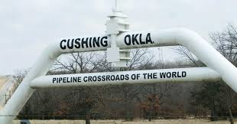
Oklahoma
Early case law: prohibited leasing cemetery lands for oil and gas purposes
Injunction for “drilling for oil in the cemetery”

Slide 50
Oklahoma
Use of “for cemetery purposes only” does not operate to reserve mineral rights
“for cemetery purposes only” does not preclude leasing for oil and gas purposes
Choctaw and Chickasaw Nations v. Board of County Commissioners of Love County, OK, 361 F2d 932 (10th Cir. 1966)

Slide 51
Oklahoma
Statutory support for drilling horizontally under a cemetery?
Explicit public polity to guard against cemeteries becoming a burden upon the community and taxpayers of the community
Maybe, if the drilling do not desecrate the cemetery, and the funds are used to protect, preserve, improve, and embellish the cemetery.

Slide 52
Louisiana
Graves not actually disturbed
But plaintiffs were awarded significant damages
Humphreys et al. v. Bennett Oil Corp., 197 So. 222 (La. 1940)

Slide 53
Louisiana
Use of the cemetery plot divested it of its sacred character, violated and profaned the sanctity of the graves. This was a desecration calculated to wound the feelings of the living who had relatives buried there
Humphreys et al. v. Bennett Oil Corp., 197 So. 222 (La. 1940)

Slide 54
Louisiana
There is testimony in the record that a marble slab, once used to mark the grave of a child, was placed at the door of the office building and used as a step
Humphreys et al. v. Bennett Oil Corp., 197 So. 222 (La. 1940)

Slide 55
Louisiana
Oil and gas lease on cemetery land is required to contain a stipulation that no drilling operations are allowed on the cemetery. (La. R.S. 8:901)
Louisiana Cemetery Board:
Drilling under cemetery in a manner that does not disturb the graves is permissible

