Slide 1
Allocation Wells & PSA Permitting/Drilling
North Houston Association of Professional Landmen
December 11, 2018

Slide 2
Allocation Wells & PSA
Permitting/Drilling
►Panelists:
►Philip Jordon – Crossing Rocks Energy, LLC
►Kelli Kenney – McElroy, Sullivan, Miller Weber, LLP
►Shandy Robl – BPX Energy
►Luke McCarley – Riviera Resources, LLC
► Moderator: Paul Yale – Gray Reed

Slide 3
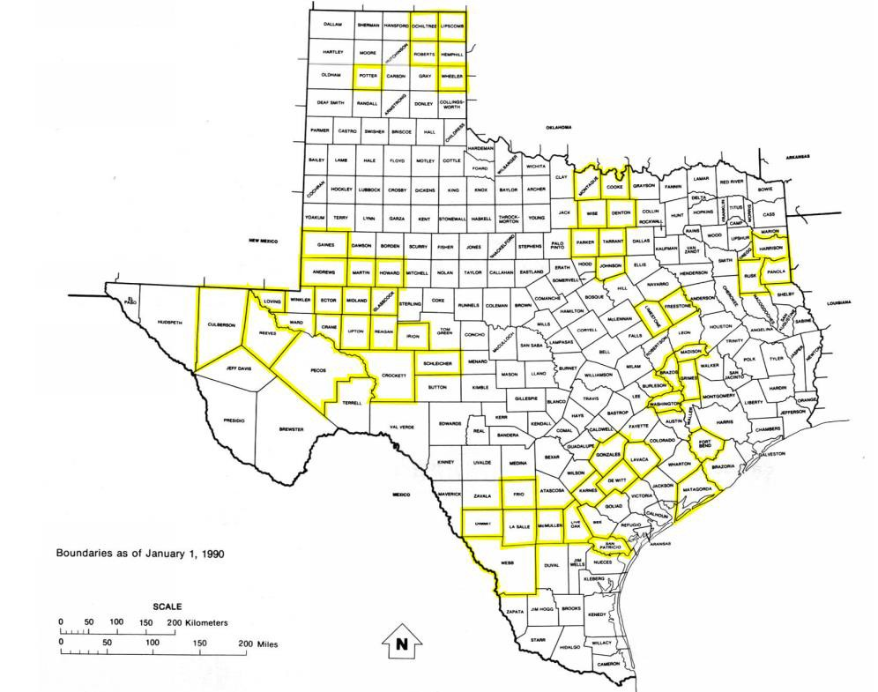
Who is Drilling PSA Wells?
As of 07/12/2018
(Thanks to Brian Sullivan of McElroy, Sullivan, Miller, Weber & Olmstead, L.L.P.)

Slide 4
Who is Drilling PSA Wells?
4P Energy Texas | 1
Amplify Energy | 5
Anadarko | 61
Apache | 47
BHP | 35
Bold Op | 12
BP America Prod | 7
Brammer | 1
Burlington | 54
Callon | 37
CCI | 12
Centennial | 3
Chesapeake | 143
Chevron USA | 16
Cimarex | 13
Cinnabar | 6
Classic | 6
CML | 1
COG | 8
Colgate Op | 1
Covey | 3
Crownquest | 7
Devon | 633
Diamondback | 12
Discovery | 12
East Texas Expl | 1
El Paso E&P | 1
Elk Meadows | 4
Encana | 2
Energen | 100
Enervest | 55
EOG | 30
Escondido | 4
EXL Petroleum Op | 1
Fidelity | 2
Foreland Op | 2
Forest | 2
Goodrich | 2
Hawkwood | 6
Hat Creek | 1
High Sky Prtns | 10
Highmount Expl | 2
Hunt Oil | 87
Jilpetco | 1
Laredo Petro | 9
Lario Oil & Gas | 5
Le Norman | 3
Lewis | 10
Linn | 4
Marathon Oil | 46
Matador Production | 17
MDC Texas Energy | 4
Memorial Prod Op | 54
Mewbourne | 2
Murphy | 9
Navidad | 1
NBL Permian | 2
Newfield | 3
NFR | 4
Oxy USA | 48
Pacesetter Energy | 1
PDC Permian | 1
Parsley Energy | 31
Patriot | 17
Penn Virginia | 30
Petroquest | 10
Pioneer | 31
PRI Op | 23
Pursuit Oil & Gas | 3
QEP | 1
Quicksilver | 2
Resolute | 23
RKI | 6
Sabalo Expl | 5
Sabine O&G | 11
Samson | 4
Silverback | 2
SM Energy | 128
Statoil | 29
Talisman | 5
Teakwood | 4
Teal Op | 2
Texakoma | 1
Texas American Res | 4
Throne Petroleum Res | 3
Titan | 1
Unit Petro | 6
Vantage | 96
Vitruvian Expl IV | 2
WBH | 19
XTO | 8
Grand Total | 2173
(Thanks to Brian Sullivan of McElroy, Sullivan, Miller, Weber & Olmstead, L.L.P.)

Slide 5
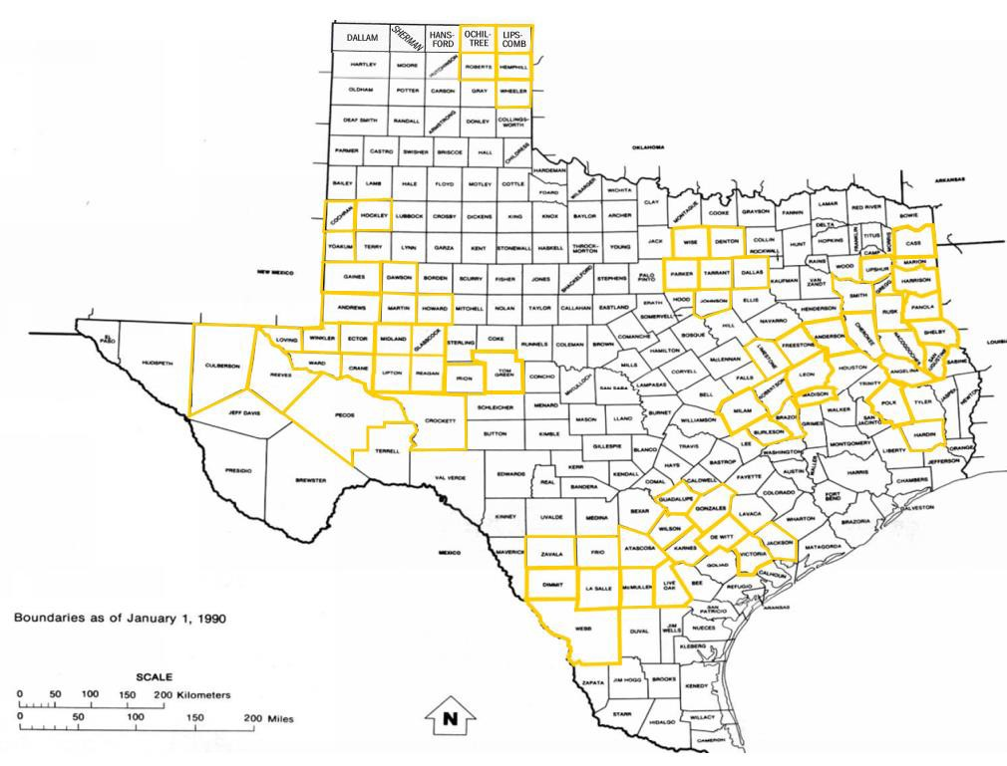
Who is Drilling Allocation Wells?
As of 07/12/2018
(Thanks to Brian Sullivan of McElroy, Sullivan, Miller, Weber & Olmstead, L.L.P.)

Slide 6
Who is Drilling Allocation Wells?
4P Energy Texas 43 Discovery 39 Hughes, Dan A. 2 Patriot 3 Shell Western | 21
Amplify Energy 1 Driftwood Energy Op 1 Hunt Oil 30 Pcore 1 Sheridan | 34
Anadarko 1 Eagle Ridge 1 Independence Res 5 PDC Permian 30 Silverbow Res Op | 7
Ajax 1 El Paso E&P 1 JPM 3 Pearl Res 1 Silver Creek | 2
American Energy PB 13 Elk Meadows Res 2 KJ Energy 7 Permian Resources 3 Silverback | 2
Ameredev LLC 3 Elm Grove Prod 2 Laredo Petro 307 Petroedge 2 ^{SM Energy} | 81
Apache 43 Encana 407 Laredo Petro – Dallas 18 Petrolegacy 2 ^{SPRI O&G} | 6
Approach Op 8 Endeavor 73 Lario 49 ^{Petroquest} 1 ^{Statoil Texas} | 42
Athlon 73 Energen 206 Legacy 58 ^{Piedra Op} 3 ^{Steward Energy} | 6
Beacon E&P 1 Energy & Expl. Ptnrs 2 Le Norman 1 ^{Pioneer} 743 ^{Summit} | 45
BHP BILLITON 45 Enervest 63 Lewis Petro 39 ^{PRI Op} 16 ^{Surge Op} | 2
Blackbrush 2 EOG 180 Lime Rock Res 3 PMO 4 ^{Swift Energy} | 35
Bold Op LLC 18 EP Energy 15 Linn 2 Quana Panhandle 1 ^{Tana Expl} | 2
BP America Prod 13 Escondido 10 Lonestar Op 4 QEP Energy 206 ^{Tanos} | 47
Brammer Eng 5 ETX 3 Manti Tarka 3 R. Lacy Services 4 ^{Teakwood Op} | 1
Breittburn Op LP 38 Exco 23 Marathon 6 Recoil Res Op 3 ^{Tecolote Energy} | 30
Burlington 26 EXL 18 Matador 11 Reliance 1 ^{TEP Barnett USA} | 22
C.W. Res 1 FDL 5 McCutchin Petro 1 Remnant Energy 1 ^{Texas Amer Res} | 1
Cabot 65 Felix Energy 16 MD America 91 Riley Permian Op 3 ^{Texas Petro Inv} | 3
Callon Petro 80 Forest 31 MDC Texas Op 7 Ring 70 ^{Three Rivers Op} | 7
Carrizo 81 Forge 21 Mewborne 1 RKI Expl Prod 50 ^{Trail Ridge} | 11
CCI East Texas 22 Fortuna Res Dvlp 3 Murphy 6 Rockcliff Energy 43 ^{Treadstone Energy} | 1
Centennial 70 Frostwood Energy 18 NBL Permian 2 Rosetta Res Op 6 ^{Trinity Op} | 6
Chesapeake 6 GHA Barnett 9 New Gulf 2 RP Operating 8 ^{Unit Petroleum} | 30
Chevron 37 GMX 11 Newark E&P 4 RSP 85 ^{Upcurve Energy} | 1
Valence Operating | 6
Cimarex 17 Grenadier Energy 1 Oasis Petroleum 13 Sabalo Expl 5 _{Verado} | 2
_{Classic 5} Goodrich 1 Obenco 9 Sabalo Operating 27 _{Walsh Petro} | 2
COG 117 Guidon Energy 36 Occidental 30 Sabinal Energy Op 2 _{W & T Offshore} | 1
Covey Park Res 1 Gulftex Energy 1 Oxy USA 57 ^{Sabine O&G} 21 _{Wildhorse} | 17
_{Crimson 4} Halcon 58 Oxy USA WTP ₈₉ Sable Permian Res 63 _{Wishbone Texas Op} | 2
Crownquest 120 Hannathon Petro 2 Pacesetter 4 ^{Saddle Op 3} _{WPX Energy Permian} | 12
DE Operating 31 Hat Creek 1 Paloma 12 ^{Samson 12} _{XTO} | 292
Devon 157 Headington Energy 10 Parallel Petro 2 ^{Scala Energy 2} _{Zarvona Energy} | 7
Diamondback 172 Henry Resources 29 Parsley 455 ^{Sea Eagle Ford 3} _{Grand Total} | 6165
(Thanks to Brian Sullivan of McElroy, Sullivan, Miller, Weber & Olmstead, L.L.P.)

Slide 7
Discussion Question
►Production Sharing Agreements vs.
Allocation Wells
►What are the advantages and disadvantages
of each?

Slide 8
Discussion Question
►Have there been any new cases of note since the Klotzman case?

Slide 9
Discussion Question
►Are companies using production sharing agreements, pooling agreements, or relying on case law for calculating royalties?

Slide 10
Discussion Question
►Are Allocation Wells the new pooling, i.e., do they eliminate the need for pooling?

Slide 11
Discussion Question
►What methods are operators most frequently using to account to royalty owners when drilling allocation wells?
► length of lateral
► number of perforations
► surface acres
► other methods

Slide 12
Discussion Question
►How to handle allocation wells that cross different JOA contract areas?
►Amend JOA
►Allocate production between JOA contract areas, and if so, where in the JOA is supporting language, and what is the risk of not being able to enforce non-consent penalties.

Slide 13
Discussion Question
►Are recent landowner lease forms addressing allocation wells by either preventing or by encouraging them?
►Examples?

Slide 14
Discussion Question
►Those pesky non-perforation zones and Rule 37 issues. How are operators handing these situations?

Slide 15
Discussion Question
►Are there better or more accurate measures of production from each tract?
►Specifically, what about the use of tracers to determine the percentage of production from each perforation?

Slide 16
Discussion Question
►You cash call the well participants for the cost of an allocation well based on the length of the proposed lateral, but the lateral does not reach the proposed length, and as a result, how would you handle the accounting to “true-up” the difference in costs between the proposed lateral and the actual as-drilled lateral.

Slide 17
Discussion Question
►Multi-tract Allocation Wells:
►Are surface easements needed down the entire lateral (across each tract)?
►Are saltwater disposal agreements needed for produced waste water on surface location tract?

Slide 18
Discussion Question
►Are subsurface easements necessary?
►In relation to surface drillsites and off-lease drillsites.

